Slide 1
CS30500: Introduction to Software Engineering
Spring 2025
Lecture #13
Prof. In-Young Ko
School of Computing

Slide 2
Software Engineering Principles
Principles
“General and abstract statements describing desirable properties of software process and product”
Methods
“General guidelines that govern the execution of some activity; they are rigorous, systematic, and disciplined approaches”
Techniques
More technical than methods and have more restricted applicability
Methodologies
Sets of methods and techniques selected for solving a problem
Tools
Tools to support the application of methodologies
Tools
Methodologies
Methods and Techniques
Principles
Change rapidly
Change slowly
Relationship between principles, techniques, methodologies and tool
[GJM02] Ghezzi et al., Fundamentals of Software Engineering
Notes:
Give an example of each.
What is more visible to users, software developers?
Which one is easier to be changed?

Slide 3
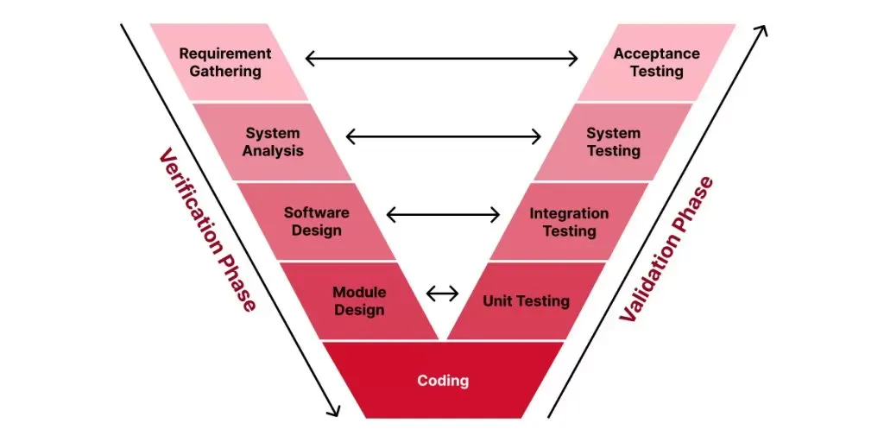
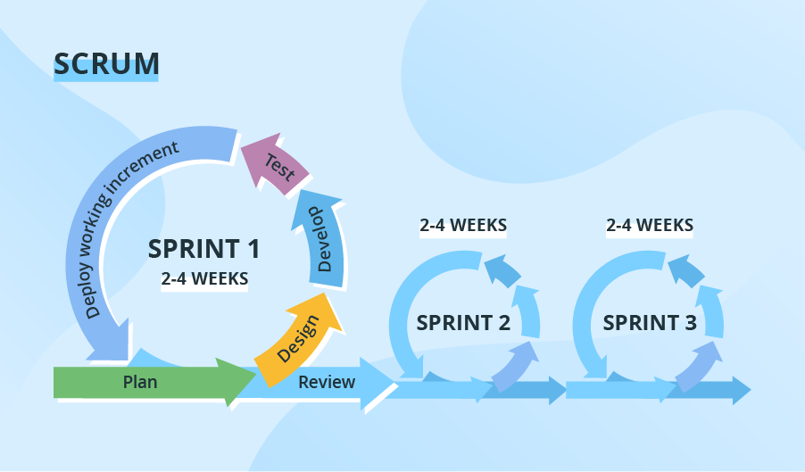
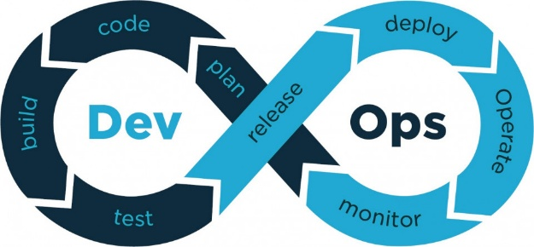
Software Engineering Principles
Rigor and Formality
Incrementality
Anticipation of Change
Generality
Modularity
Abstraction
Separation of Concerns
[Shi19]
https://reliasoftware.com/blog/v-model
https://www.easyredmine.com/news/devops-for-easy-redmine-a-new-perspective-to-software-development-for-all-redminers
http://www.uml-diagrams.org/airport-checkin-uml-use-case-diagram-example.html

Slide 4

Software Engineering Principles are for …
Understanding what to develop
Developing software the right way
Developing the right software
by effectively collaborating with
stakeholders, including
customers, users, and developers.
https://www.linkedin.com/pulse/go-digital-why-diverse-inputs-multi-stakeholder-feedback-chris-leong/

Slide 5
Topics Covered and To-be Covered
Understanding what to develop
Introduction to Software Engineering (Software Process & Project Management)
Software Requirements Engineering
Developing software the right way
SE Principles: Separation of Concerns, Abstraction, Modularity, etc.
Process Models: Heavy-weight process, Prototyping, Agile, DevOps,..
Basics of UML (Unified Modeling Language)
Software Design: Architectural Patterns, Resilient Design Patterns
Developing the right software
Software Quality: Correctness, Robustness, Safety, Security, etc.
Software Testing: Testing overview, Black-box and White-box testing

Slide 6
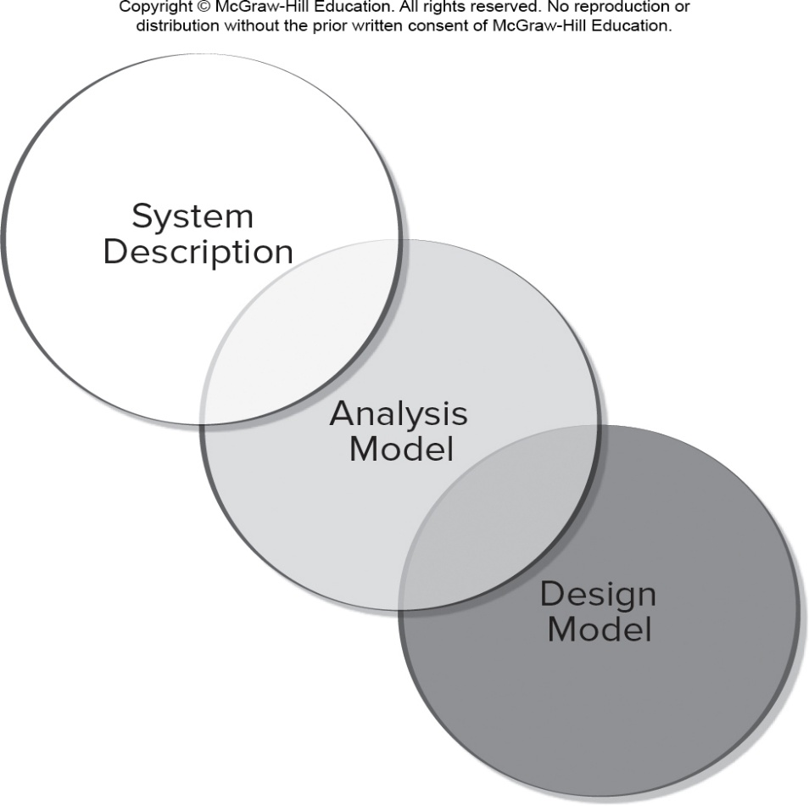
Requirements Analysis to Design
Specifies software’s operational characteristics
Indicates software's interface with other system elements
Establishes constraints that software must meet
Requirements analysis allows the software engineer to:
Elaborate on basic requirements established during earlier requirement engineering tasks
Build models that depict the user’s needs from several different perspectives
Traceability
(e.g., use case diagram use case description)
(e.g., sequence diagram )
(e.g., state diagram class diagram)
[PrMa20 ]

Slide 7
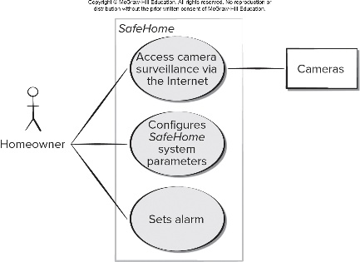
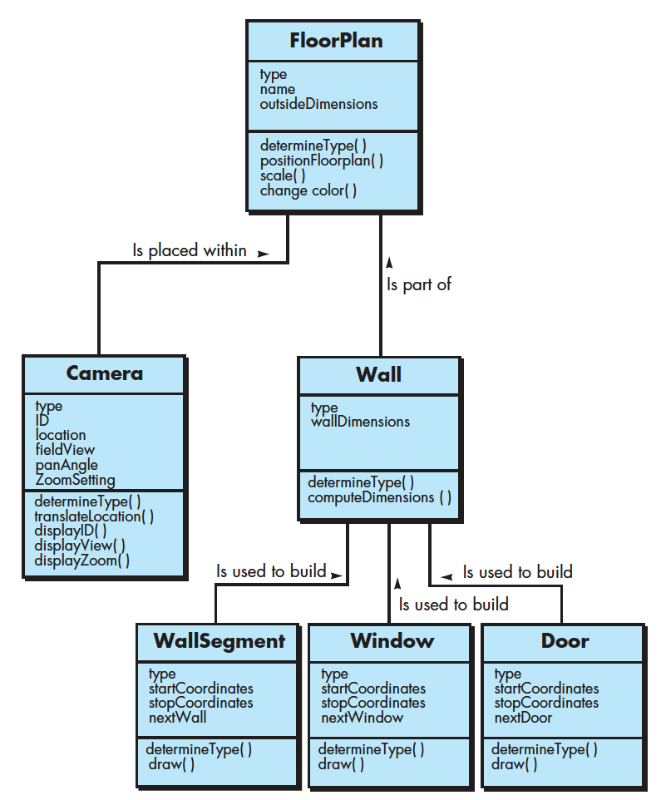
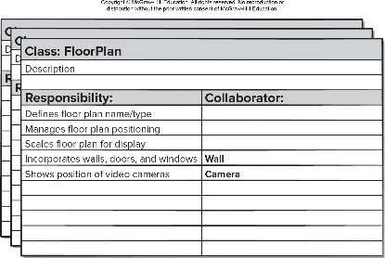
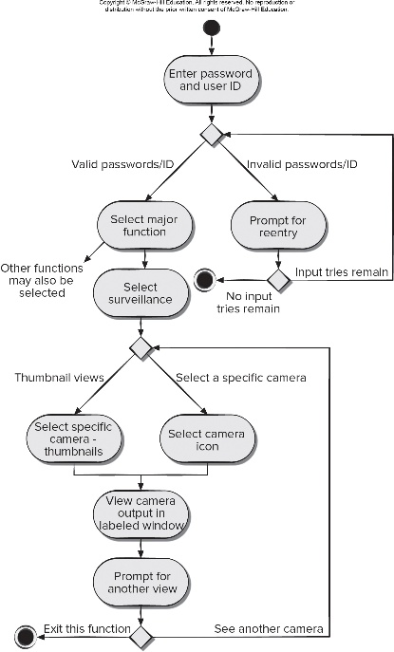
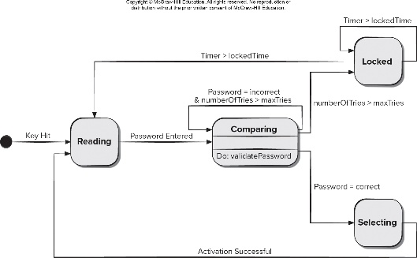
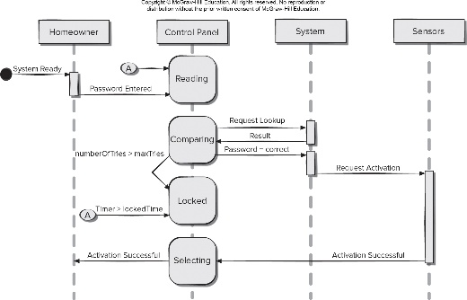
Requirements and Design Models
[PrMa20 ]
Scenario-based models
Depict requirements from the point of view of “actors”
e.g., storyboards, use case model
Class-oriented models
Represent object-oriented classes (attributes and operations) and how classes collaborate
e.g., class diagrams, CRC model
Behavioral models
Depict how the software reacts to internal or external “events”
e.g., control flow diagrams, Petri nets, sequence diagrams, activity diagrams, state diagrams

Slide 8
Today’s Plan
Requirements Models
Scenario-based modeling
Class-based modeling
Behavioral modeling
Domain modeling
Traceability

Slide 9
Behavioral Modeling

Slide 10
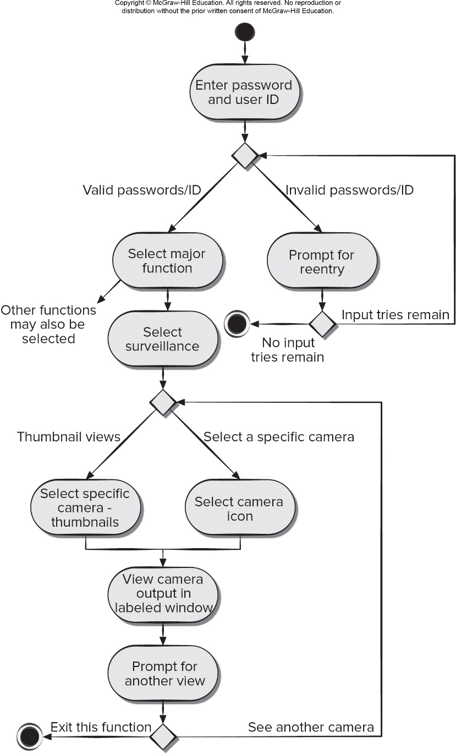
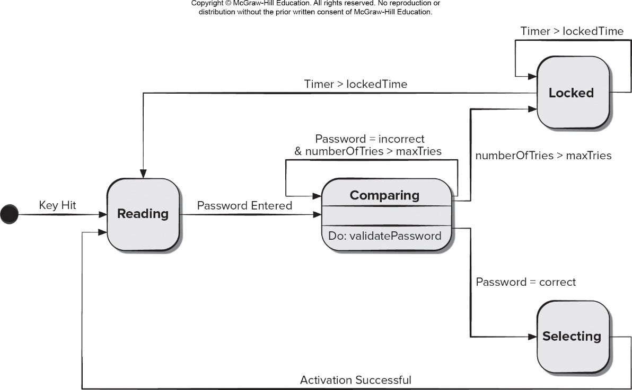
Behavioral Modeling
A behavioral model indicates how software will respond to internal or external events or stimuli
U M L state diagrams can be used to model how system elements respond to external events
U M L activity diagrams can be used to model how system elements respond to internal events
Activity Diagram
State Diagram

Slide 11
Creating Behavioral Models
Evaluate all use cases to fully understand the sequence of interaction within the system
Identify events that drive the interaction sequence and understand how these events relate to specific objects
An event occurs whenever the system and an actor exchange information
Create a sequence diagram for each use case
Events are used to trigger state transitions
Build a state diagram for the system
Review the behavioral model for accuracy and consistency
Name | Make reservation
Summary | Reservation clerk reserves a room for a guest
Actor | Reservation clerk
Precondition | Reservation clerk has logged into the system
Description | Guest gives personal details to reservation clerk, such as name, room type, number of occupants, and dates and times of arrival and departure Reservation clerk enters information into the system and looks up availability and room reservation rate If room is available, clerk requests the guest to guarantee the reservation with a credit card number The clerk enters the guest’s credit card number to guarantee the reservation. If credit card number is valid, the clerk updates the reservation as guaranteed.
Alternatives | Room not available: Line 3: If a room is not available, clerk requests the customer for another date and / or time of arrival and departure Invalid card: Line 5: If the credit card number is not valid, the clerk requests the customer for another credit card number
Postcondition | The reservation is created for the guest.

Slide 12
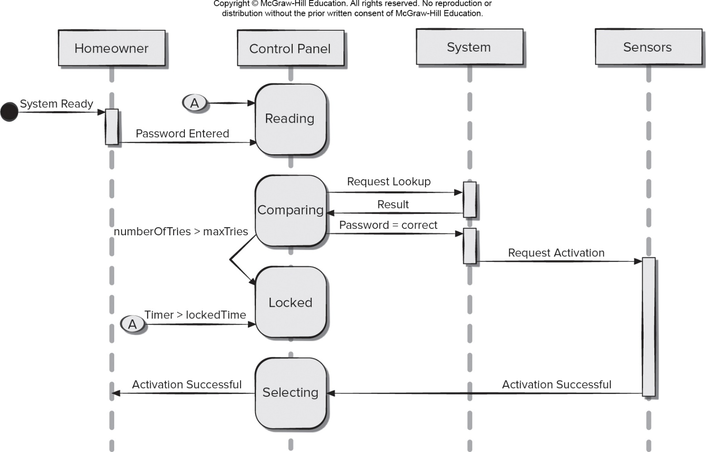
Sequence Diagram
Sequence diagrams can be used to show how events cause transitions from object to object
Sequence diagram is a shorthand version of a use case
[PrMa20 ]

Slide 13
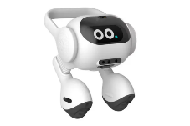
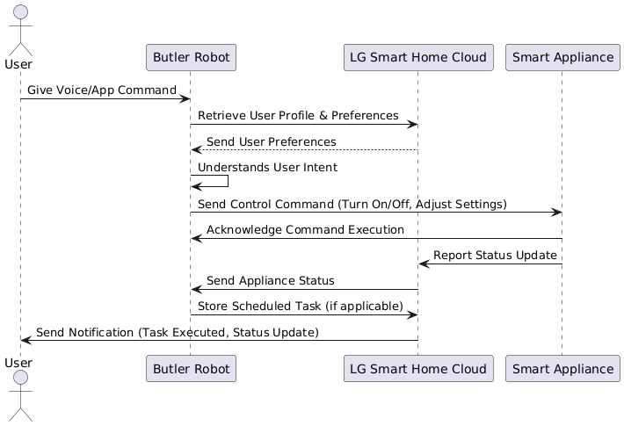
Sequence Diagram Generated by ChatGPT + UML Diagram Creator

Slide 14
Domain Modeling

Slide 15
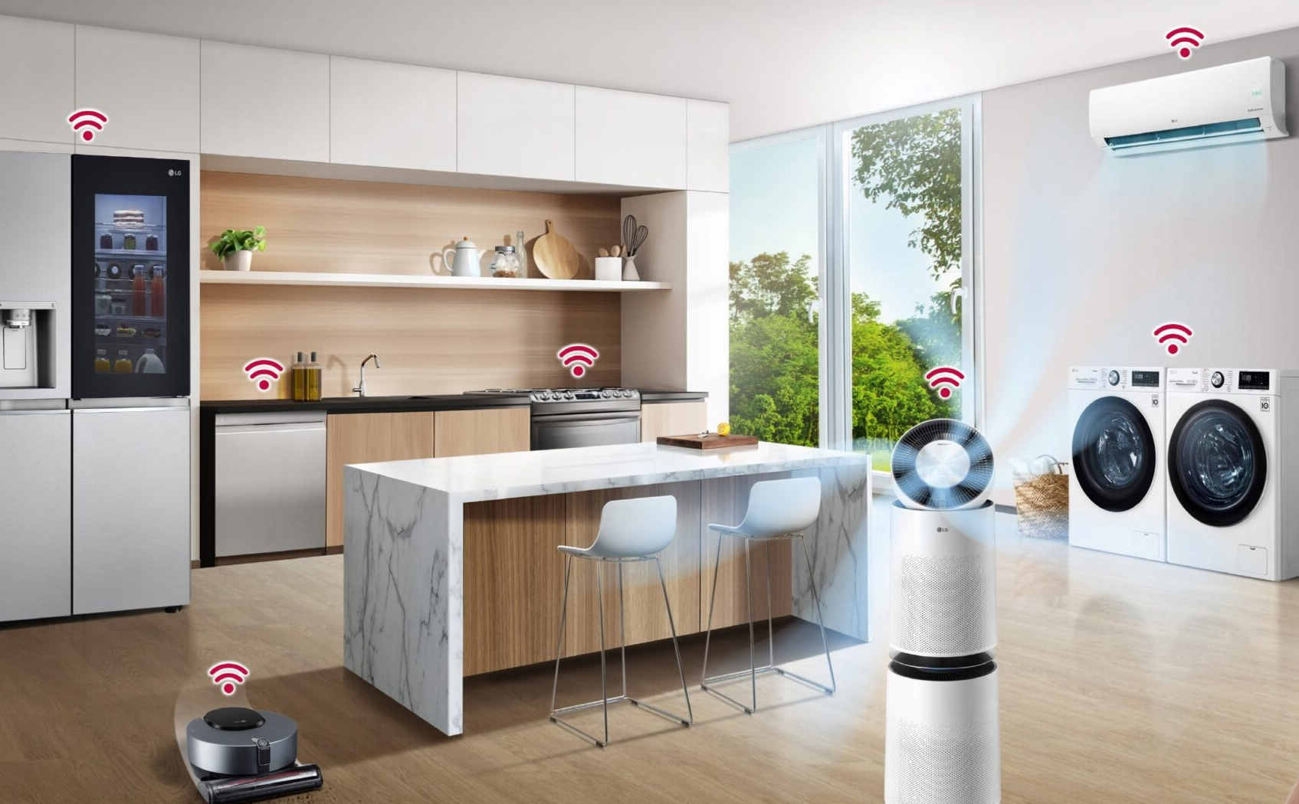
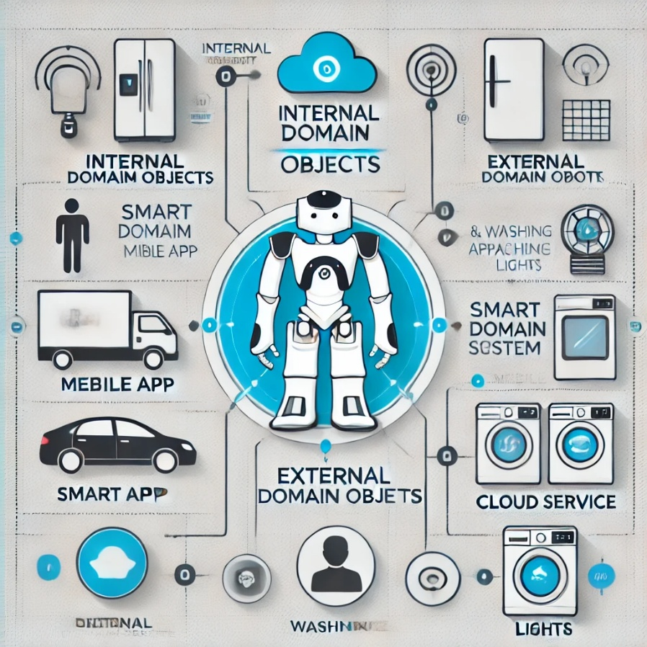
As a Software Engineer…
Your task is to design and develop a smart home system where a butler robot understands the user's needs and seamlessly controls and coordinates home appliances.
External and internal domain objects?
[Generated by ChatGPT 4o]

Slide 16
Domain Objects Found by ChatGPT
Domain Object | Description
User | Represents the homeowner or resident interacting with the system.
VoiceCommand | A user-issued verbal instruction that the system needs to interpret.
MobileApp | The user interface through which users control and monitor the system.
ButlerRobot | The central AI system that interprets, coordinates, and executes commands.
Intent | The parsed and interpreted meaning of a user command (e.g., “turn on lights”).
Command | A system-generated instruction sent to an appliance or subsystem.
Schedule | Represents a time-based automation or routine for appliances.
Room | A physical location (e.g., kitchen, bedroom) where appliances are placed.
Device (Appliance) | Base class for smart appliances like AC, lights, washer, etc.
├─ SmartLight | A light that can be turned on/off, dimmed, or scheduled.
├─ SmartAC | An air conditioner with temperature and mode controls.
├─ SmartFridge | A refrigerator capable of reporting temperature, status, etc.
├─ WashingMachine | A smart washer with status reporting and scheduling capabilities.
DeviceStatus | Real-time or historical state of an appliance (on, off, current temp, etc.).
UserProfile | Contains user preferences, access level, language, etc.
Notification | Alerts or messages sent to the user via mobile or voice.
AuthenticationToken | Represents user identity verification for access control.
WiFiConnection | Represents network details and status for appliances and the robot.
CloudService | Backend services handling API routing, storage, and integration.
LogEntry | A record of commands, errors, or events for auditing and monitoring.
[Generated by ChatGPT 4o]

Slide 17
Domain Modeling (1/2)
Why? — To understand how system-to-be will work
Requirements analysis determined how users will interact with system-to-be (external behavior)
Domain modeling determines how elements of system-to-be interact (internal behavior) to produce the external behavior
Where? — Based on the following sources:
Knowledge of how system-to-be is supposed to behave (from requirements analysis, e.g., use cases)
Studying the work domain (or, problem domain)
Knowledge base of software designs
Developer’s past experience with software design
Adopted from Prof. Doo-Hwan Bae’s CS350 lecture material

Slide 18
Domain Modeling (2/2)
What?
Illustrates meaningful conceptual classes in a problem domain
Is a representation of real-world concepts, not software artifacts
Is the most important objects/classes in OO development
Decompose the system into a set of objects, rather than functions!
How?
Identify nouns and noun phrases in textual descriptions of the domain
Use use case descriptions
Add associations for relationships that must be retained
Add attributes necessary for information to be preserved
Adopted from Prof. Doo-Hwan Bae’s CS350 lecture material
Notes:
Real-world concept vs. software artifacts
User vs user info (record in DB)

Slide 19
Use Case Modeling vs. Domain Modeling
In use case analysis, we consider the system as a “black box”
In domain analysis, we consider the system as a “transparent box”
Adopted from Prof. Doo-Hwan Bae’s CS350 lecture material

Slide 20
Example: ATM Machine
Identifying Classes for ATM
Identify all the nouns or noun phrases from use case descriptions
Customer, bank, ATM, (bank) account, funds, cash, keypad, screen, cash dispenser, cash deposit slot, user, checking account, saving account, card, password, transaction, receipt, bookkeeping, request.
Eliminate redundant, irrelevant, implementation constructs, attributes, etc.
Adopted from Prof. Doo-Hwan Bae’s CS350 lecture material

Slide 21
Building Domain Model from Use Cases
Step 1: Identifying the boundary concepts
Step 2: Identifying the internal concepts
Adopted from Prof. Doo-Hwan Bae’s CS350 lecture material

Slide 22
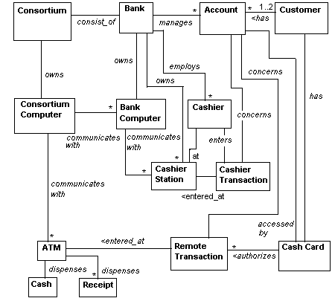
Initial Class Diagram (Domain Model) for ATM
Objects: ATM, Keypad, Deposit slot, Cash dispenser, Screen, Transaction, Bank, Account, Customer
Draw a class diagram with only class names and relationships
Adopted from Prof. Doo-Hwan Bae’s CS350 lecture material

Slide 23
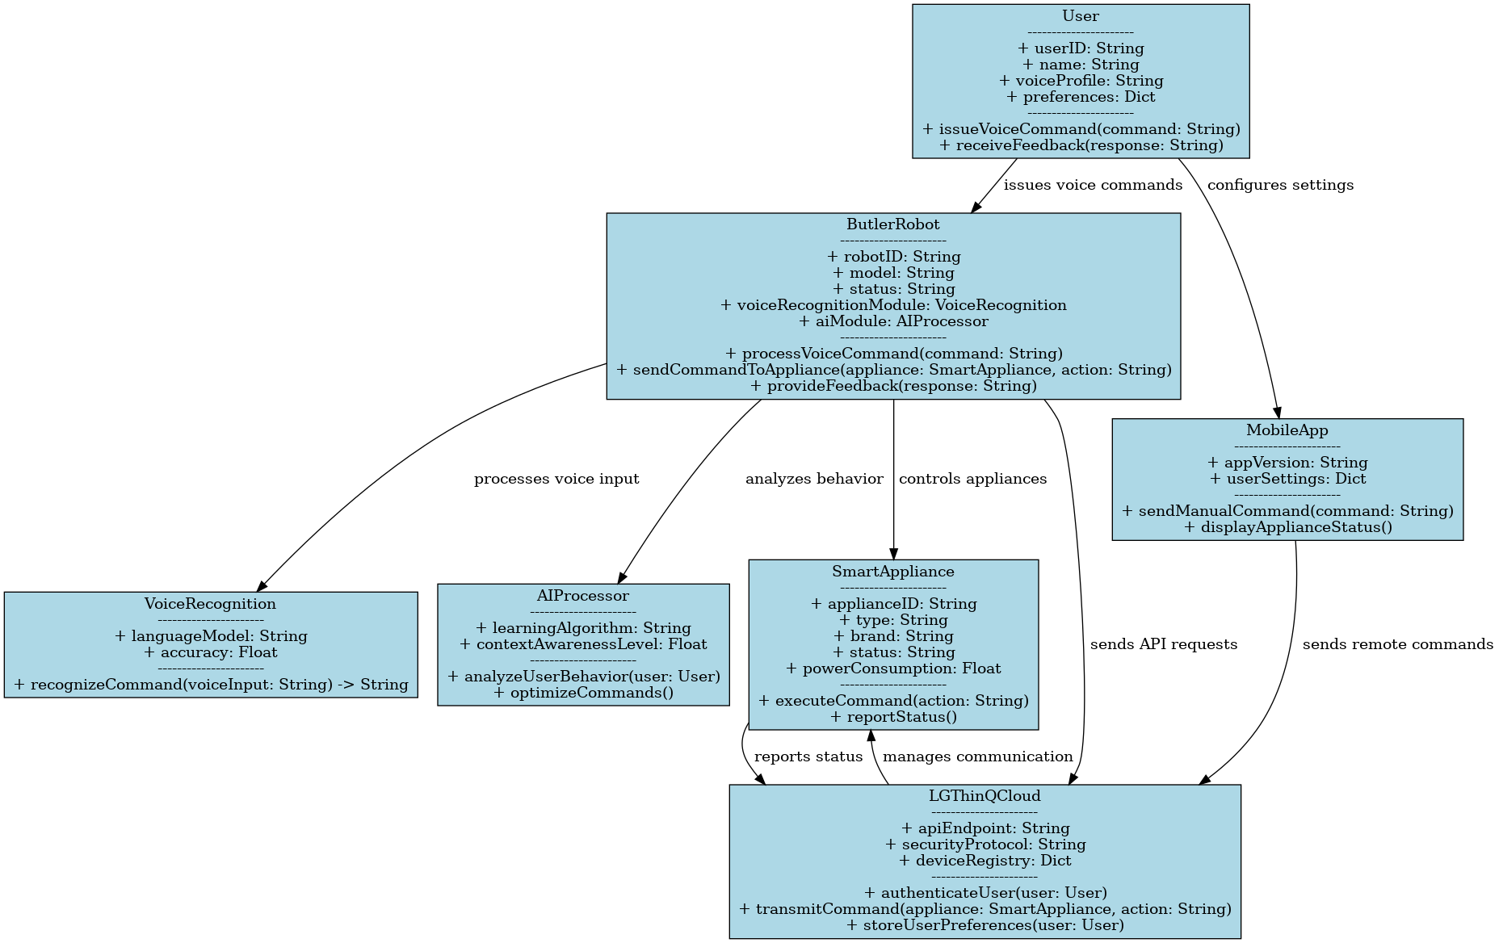
Domain Model Generated by ChatGPT

Slide 24
Traceability

Slide 25
From Use Cases to Objects (2/2)
Jacobsen, Booch, Rumbaugh view [JBR 1999] - RUP
Use Case Model
Specified by
Realized by
Analysis Model
Distributed by
Design Model
Implemented by
Deployment Model
Verified by
X
OK
Implementation Model
X
OK
X
OK
The content of this slide is adopted from the lecture materials of the Methods course (17-652) at Carnegie Mellon University.
Test Model

Slide 26
Use Case Realizations
Use case model
Analysis model
Dispenser
Withdrawal
Withdraw Money
Bank Customer
Transfer between Accounts
Bank Customer
Cashier Interface
Transfer
Account
Deposit Money
Money Receptor
Deposit
Use case model
Design model
<trace>
participating classes
The content of this slide is adopted from the lecture materials of the Methods course (17-652) at Carnegie Mellon University.
Notes:
Interface objects, Control objects, Entity objects.

Slide 27
Test Cases
Use Case Model
Test Case Model
Use Case 1
Test Case 1
Use Case 2
Test Case 2
Use Case 2.1
(traceability links)
The content of this slide is adopted from the lecture materials of the Methods course (17-652) at Carnegie Mellon University.

Slide 28
Test Case Design
Test case for ‘Control Light’ use case
Test Case ID | Event description | Input 1 | Input 2 | Expected Result
 |  | Basic Flow
2001 | Resident presses control switch | Any enabled button | Light was on before button pressed | Light is turned off
2002 |  |  | Light was off | Light is turned on
2003 | Resident releases button in less than 1 second | Light on |  | Stays off
2005 | Resident releases button in less than 1 second | Light off |  | Stays on
The content of this slide is adopted from the lecture materials of the Methods course (17-652) at Carnegie Mellon University.

Slide 29
Traceability Relationship
The degree to which a relationship can be established between two or more products of the development process
The degree to which each element in a software product establishes its reason for existing
Predecessor-successor relationships
Master-subordinate relationships
The content of this slide is adopted from the lecture materials of the Methods course (17-652) at Carnegie Mellon University.

Slide 30
Neglecting Traceability Results in
Loss of knowledge
Misunderstandings, miscommunication
Losing even the simplest, but very crucial aspects of the overall software development life cycle
e.g., Where did this use case come from?
Unnecessary revisions, thus increased cost and time
The content of this slide is adopted from the lecture materials of the Methods course (17-652) at Carnegie Mellon University.

Slide 31
Questions?

Slide 33
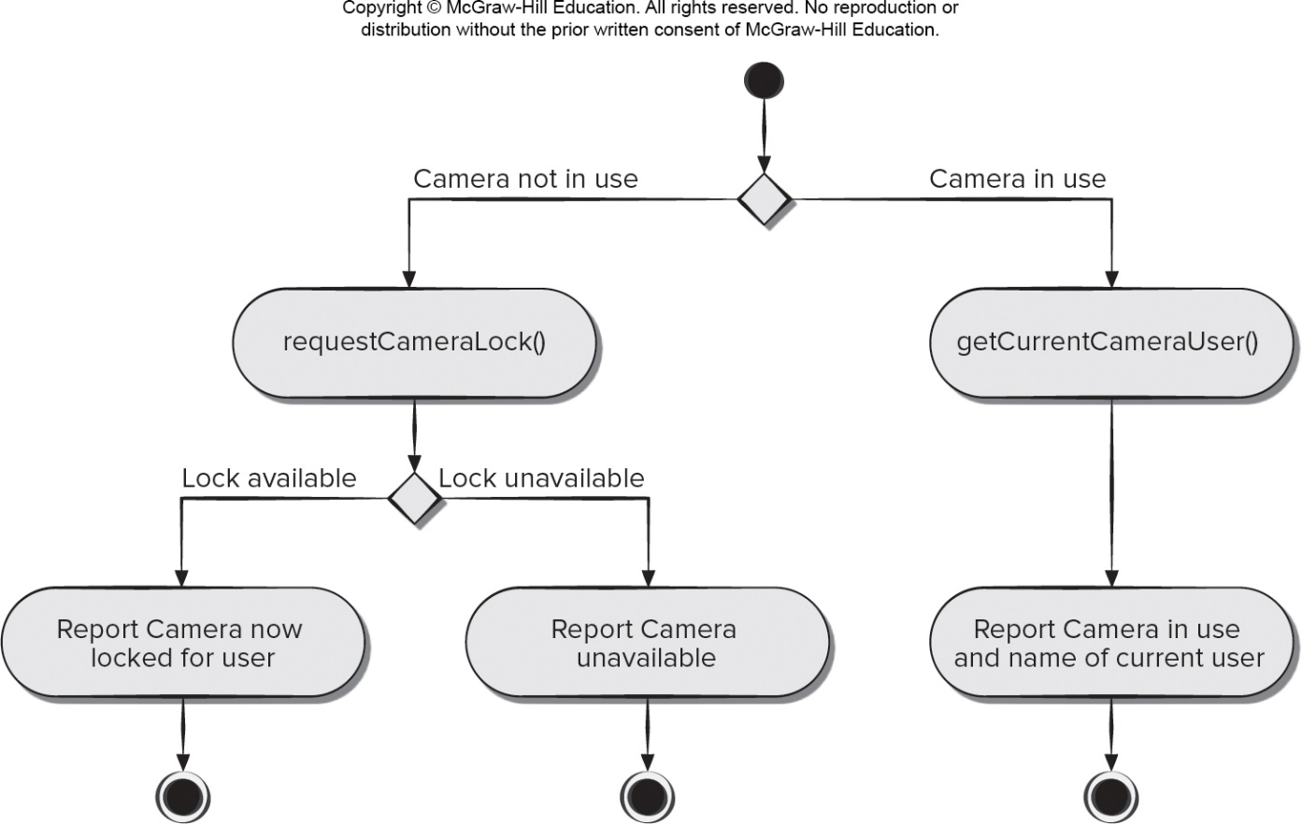
Functional Modeling
The functional model addresses two application processing elements:
User-observable functionality that is delivered by the app to end users
Operations contained within analysis classes that implement behaviors associated with the class
U M L activity diagrams can be used to represent processing details
U M L activity diagram supplements a use case by providing a graphical representation of the flow of interaction within a specific scenario
[PrMa20 ]

Slide 34
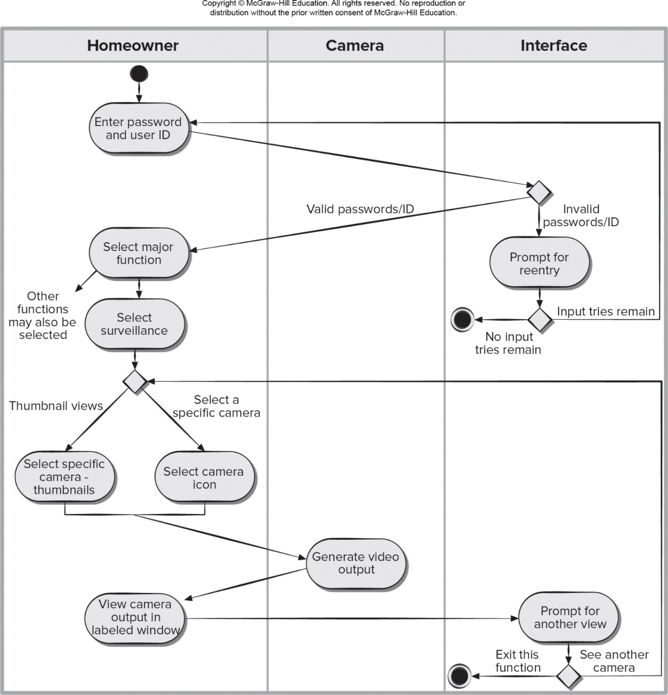
Swimlane Diagrams
A variation of the activity diagram that represents the flow of activities described by the use case
Indicates which actor or analysis class has responsibility for the action described by an activity rectangle
Responsibilities are represented as parallel segments that divide the diagram vertically, like the lanes in a swimming pool
[PrMa20 ]

